Slide 1

Wavelet Filter Design for Financial Time Series
Comprehensive Implementation and Analysis

Slide 2
Group No. 12 Team Members :
UTKARSH BHARDWAJ – CB.EN.U4CCE21076
H M DORA – CB.EN.U4CCE21023
SAHIL KUMAR– CB.EN.U4ECE21147

Slide 3
Introduction to Filter Design
Filter design is a vital tool in signal processing. Its significance includes:
Removing noise from signals.
Enhancing critical features for analysis.
Extracting specific components for interpretation.
Wavelet-based filters are particularly suited for non-stationary signals such as financial data.

Slide 4
Principles of Wavelet Filters
Wavelets are mathematical functions used to decompose data into different scales.
Key features:
Localized in both time and frequency domains.
Can separate high-frequency noise and low-frequency trends.
Provide multi-resolution analysis for detailed insights.

Slide 5

Applications in Financial Time Series
Financial data is non-stationary, exhibiting:
- High-frequency volatility (e.g., daily price changes).
- Long-term trends (e.g., market growth).
Wavelet filter applications:
- Noise reduction for clearer analysis.
- Trend detection for long-term strategies.
- Feature extraction for predictive modeling.

Slide 6
Python Libraries for Implementation
1. PyWavelets (pywt): Performs wavelet transformations.
2. NumPy: Enables numerical computations.
3. Matplotlib: Visualizes signals and results.
4. Pandas: Handles and processes time-series data.

Slide 7
Code Implementation Overview
The methodology involves:
1. Generation of financial time series with noise.
2. Decomposing the signal using wavelets.
3. Reconstructing the signal to remove noise.
4. Visualizing and analyzing the results using Super-trend
as an indicator.

Slide 8
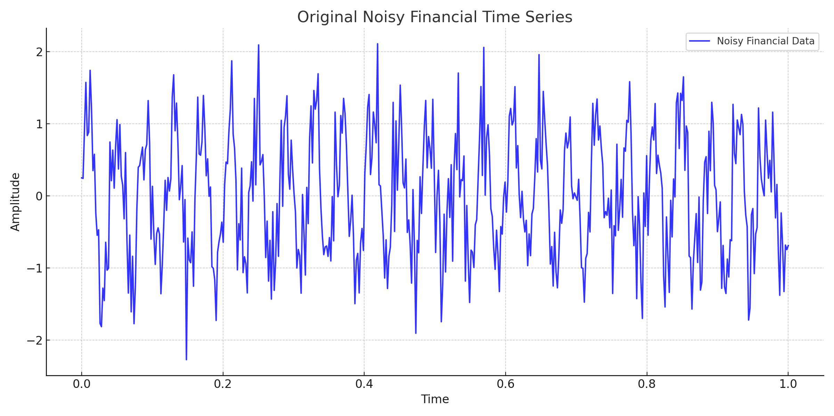
Step 1: Generation and Simulation of Financial Time Series

Slide 9
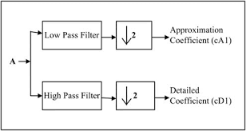
Step 2: Decomposing the Signal
The signal is decomposed using Daubechies wavelet (db4):
Approximation coefficients: Represent low-frequency components (trends).
Detail coefficients: Represent high-frequency components (noise).
This separation helps analyze the signal effectively.

Slide 10
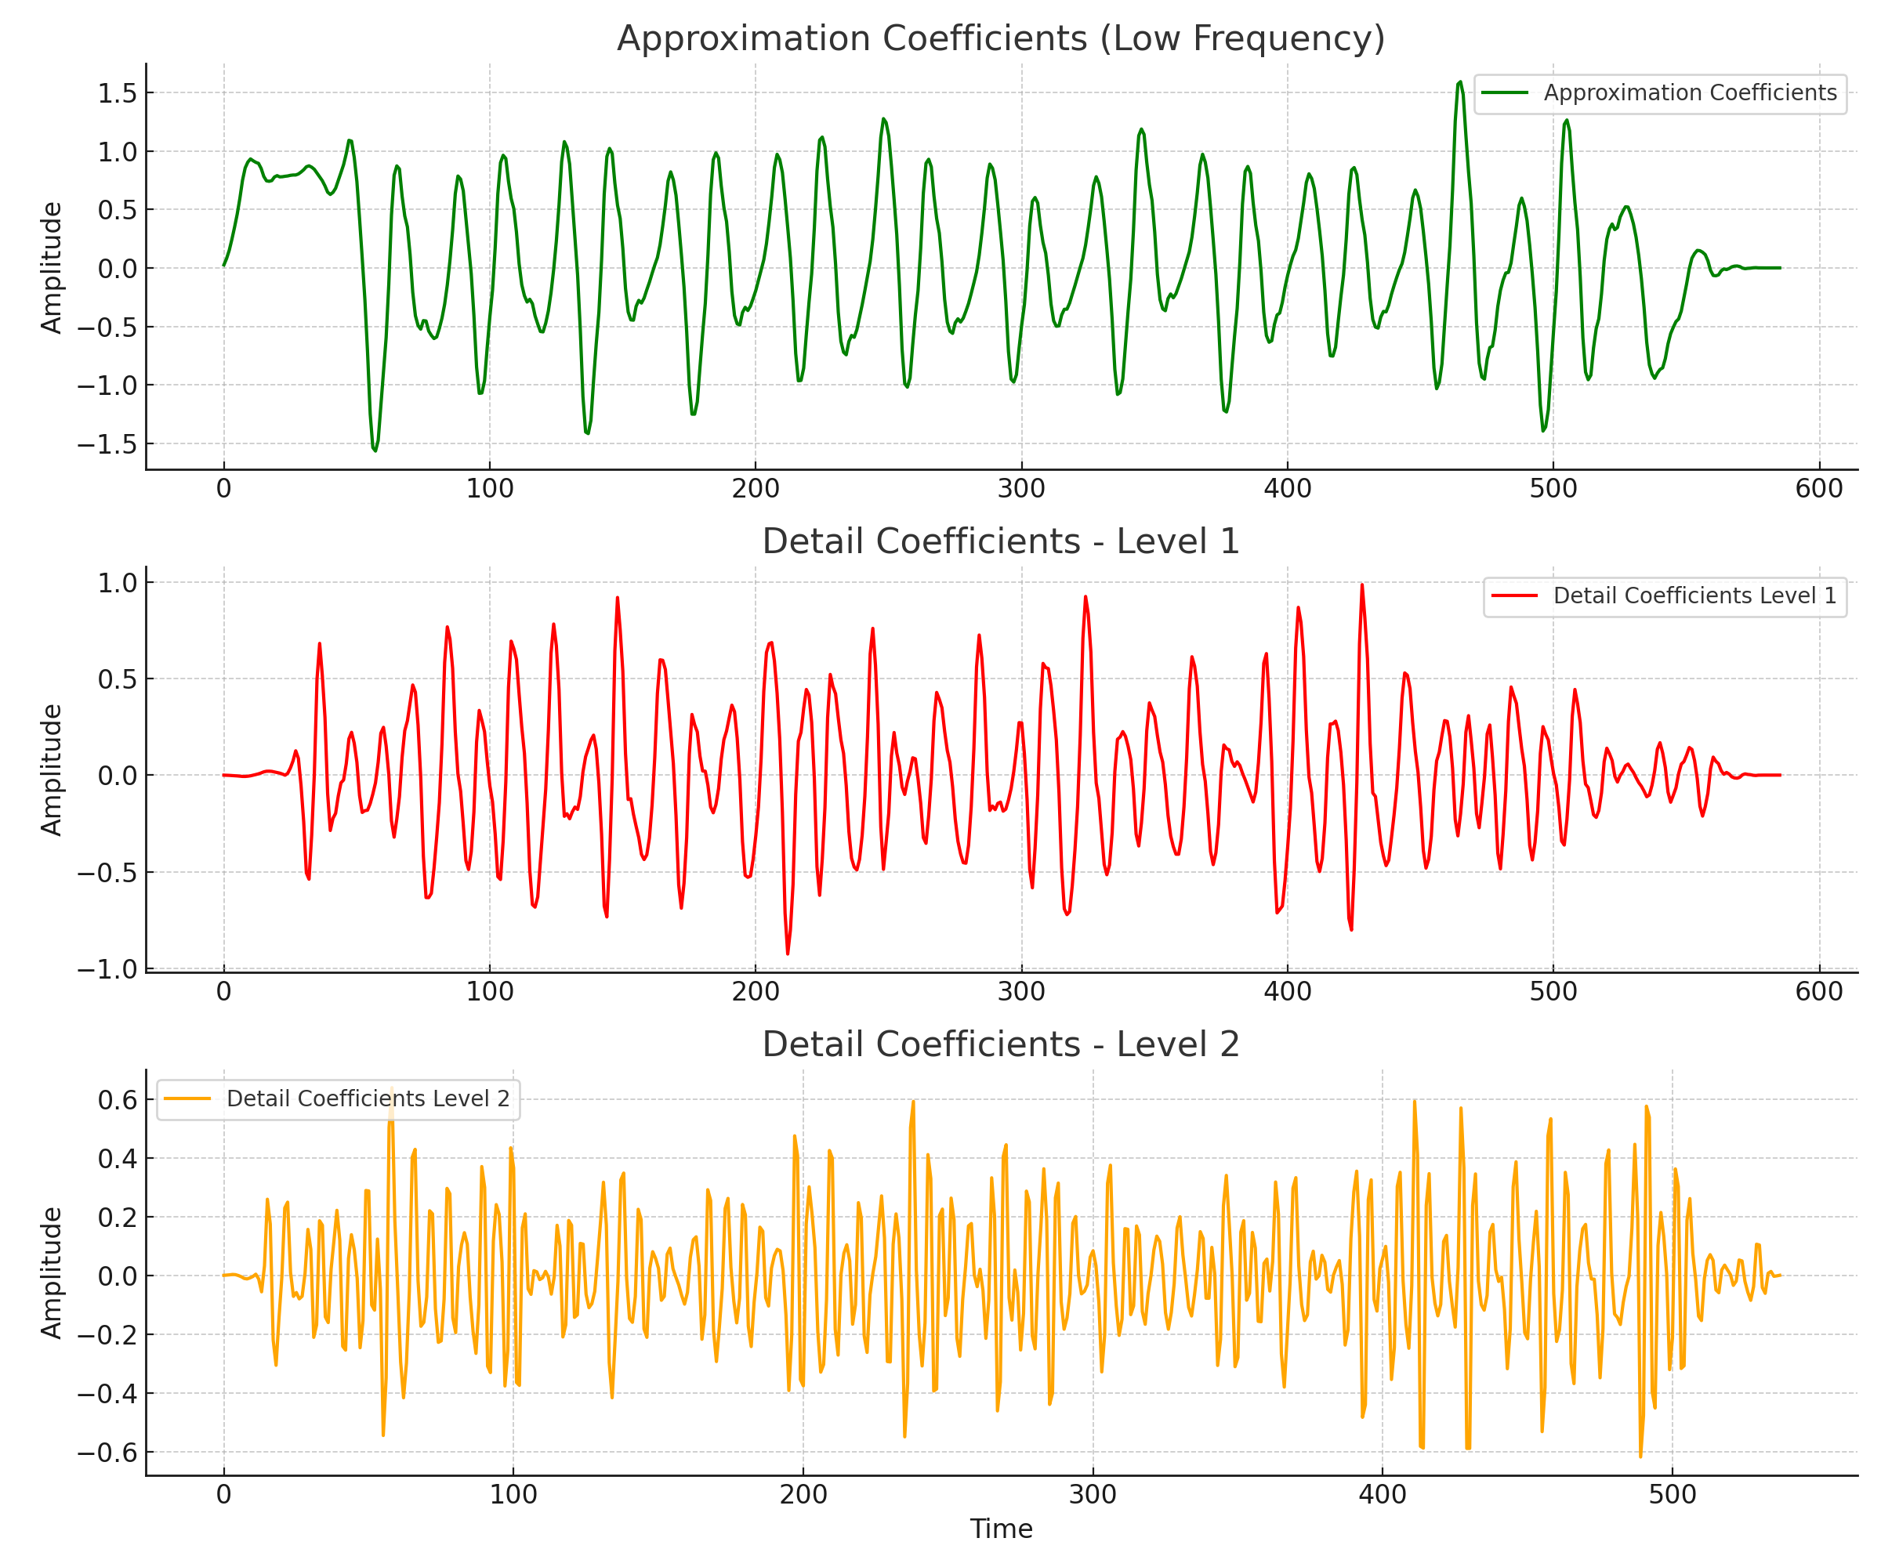
Visualizing Signal Decomposition

Slide 11
Step 3: Reconstructing the Signal
Reconstruction uses approximation coefficients to:
Retain essential trends.
Remove high-frequency noise.
This process produces a clean signal suitable for analysis.

Slide 12
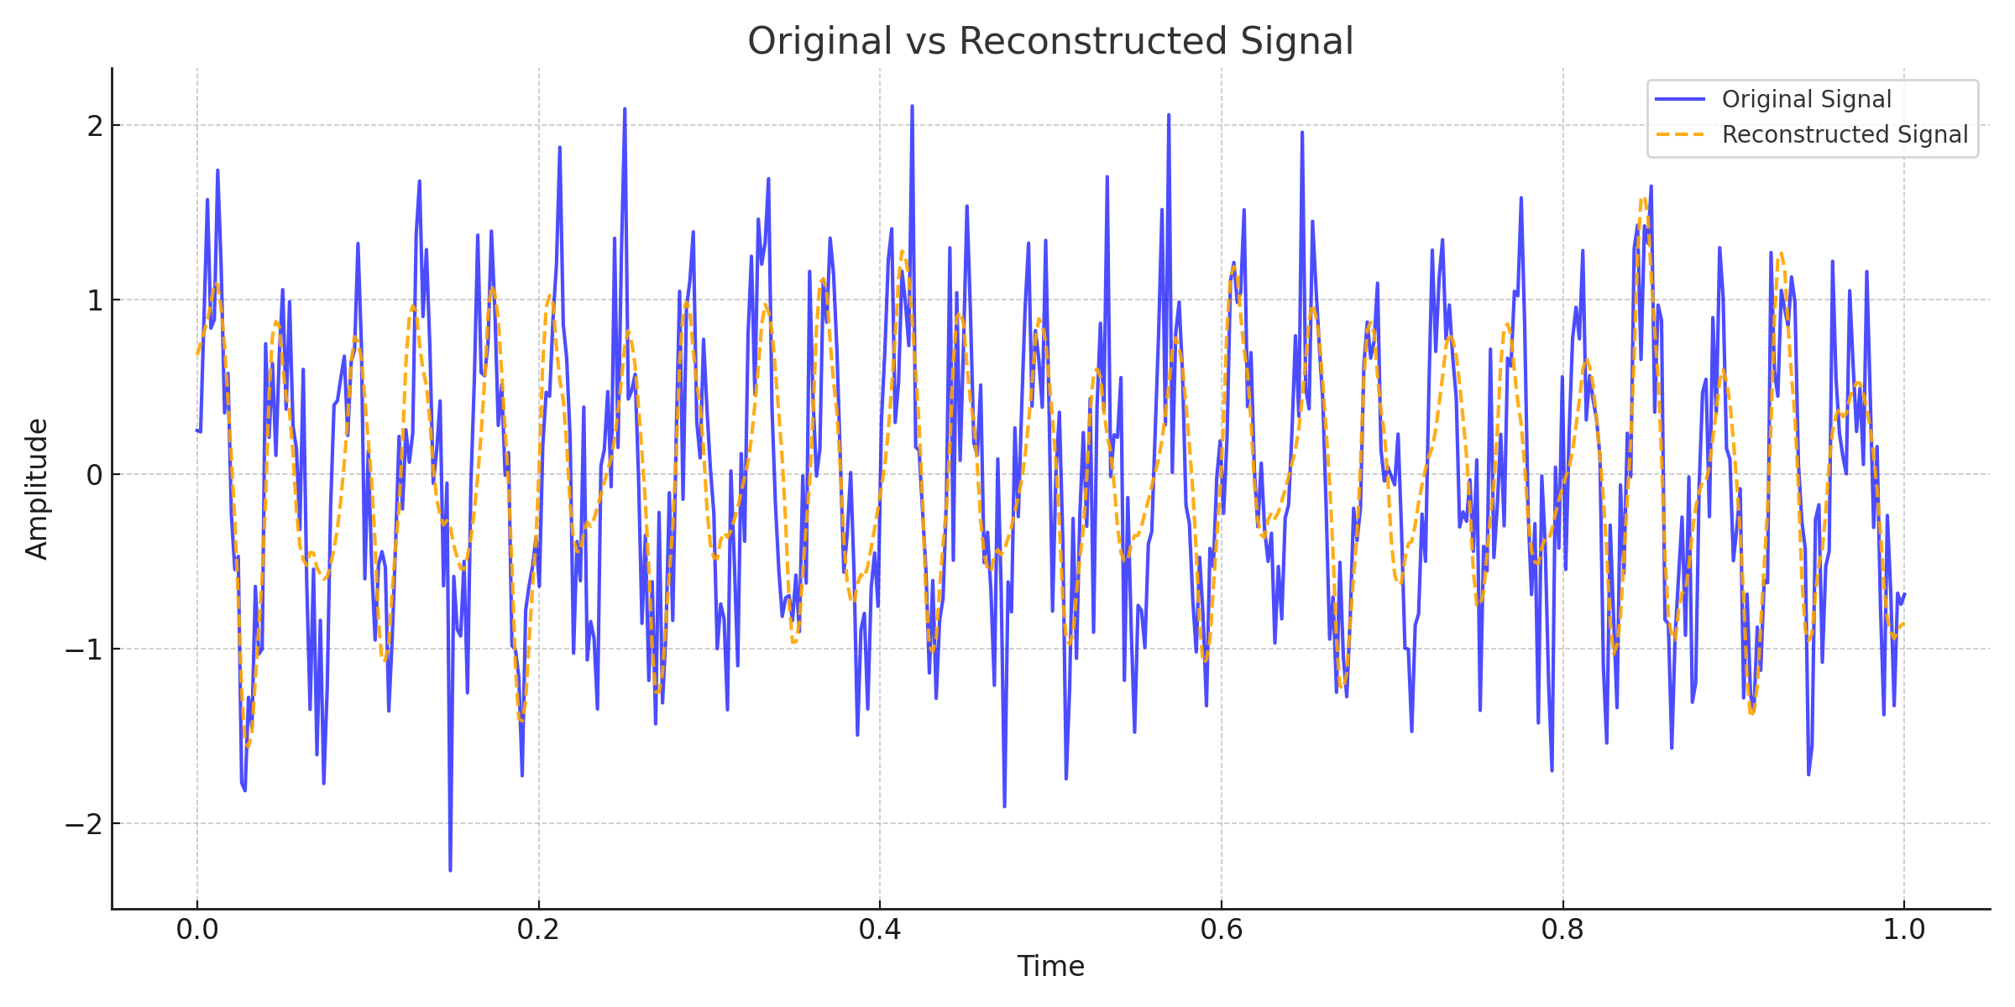
Results: Original vs. Reconstructed

Slide 13
Supertrend
What is Supertrend ?
A trend-following indicator used in technical analysis to identify bullish and bearish trends in the market.
Provides buy signals when the trend turns bullish and sell signals when the trend turns bearish.
How it Works:
Supertrend is plotted as a line on the price chart.
Below the price: Indicates a bullish trend.
Above the price: Indicates a bearish trend.
It adjusts dynamically based on volatility and price movement.

Slide 14
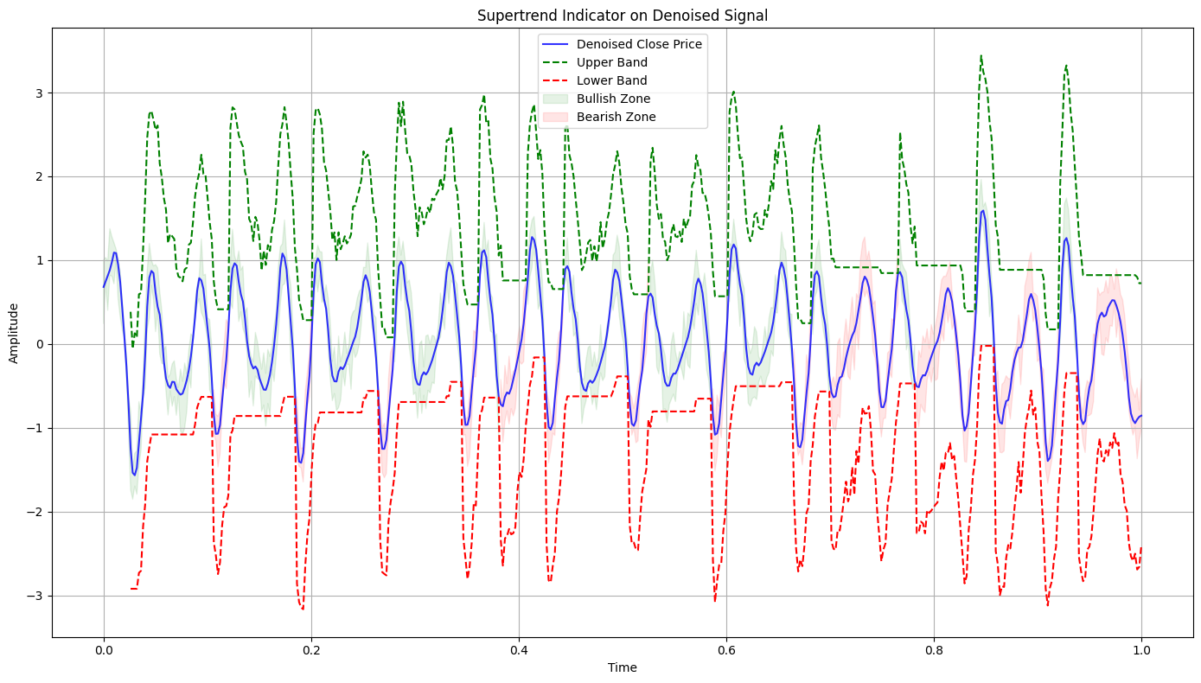
Evaluation of Signal w.r.t. Super-trend

Slide 15
Inferences and Insights
Effective Noise Reduction and Trend Preservation
Enhanced Signal for Technical Analysis
Accurate Market Trend Detection
Versatility of Wavelet Transform
Improved Decision-Making in Financial Markets

Slide 16
Challenges and Limitations
Dependency on Parameter Selection
Loss of Fine Details
Lagging Nature of the Supertrend
Limited Adaptability to Market Variability

Slide 17
Future Applications
Wavelet filter design can be extended to:
Advanced Risk Management
Algorithmic Trading Enhancements
Integration with Machine Learning Models
Multi-Asset Financial Analysis

Slide 18
Conclusion
Wavelet filter design offers a robust framework for analyzing complex financial time series. It provides noise reduction, trend extraction, and multi-scale analysis, making it invaluable for financial decision-making and predictive analytics.

Slide 19


